Slide 1
COMPUTER WIZARD
An Automated System For Managing a Computer Institution
Presented by
Moumita Guha Roy (roll-99) Swarnali Mukherjee (roll-93)

Slide 2
INTRODUCTION
Our project is to design an automated system for managing a computer institution.
Till now the institution was a manual system. Our software makes the institution an automated one.
Automated system gives the member of the institute the convenience to solve any problem regarding the institute as early as possible.

Slide 3
OBJECTIVES
This automated system helps to manage the institute more efficiently.
Many work such as keeping the details of the students, instructors, and the courses that are taught in the institute, generating the students’ result, calculating the profit of the institute involves human labor if done manually.
Saves time in many aspects.
Unauthorized access to the system can be prevented effectively if the system is made an automated one.

Slide 4
FEATURES OF THE SOFTWARE
Storing detailed record about all the students.
Storing detailed record about all the faculties (instructors).
Storing detailed record about each course such as course description, duration.
Storing result of each student.
Calculating grades obtained by each student.
Calculating the profit of the institute.
Printing facility of course details and profit of the institute.
Secured from unauthorized accessed.

Slide 5
FUNCTION ORIENTED DESIGN
(DATA FLOW DIAGRAM)

Slide 6
PHYSICAL DFD

Slide 7
LEVEL 0

Slide 8
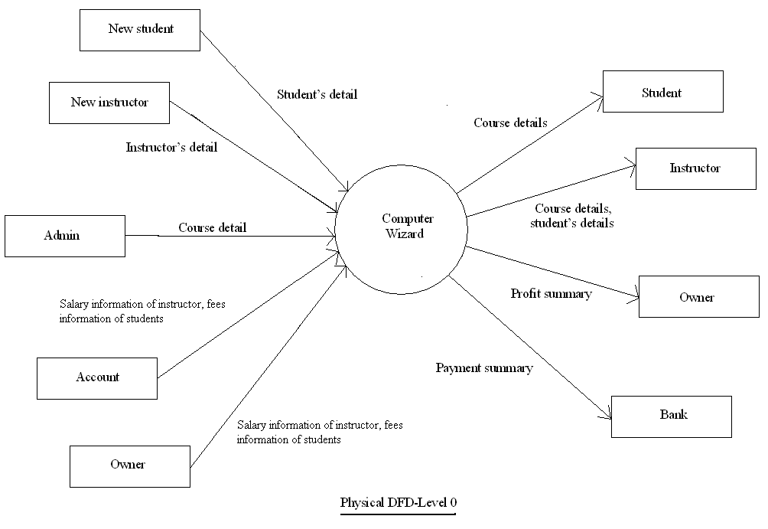

Slide 9
LEVEL 1

Slide 10
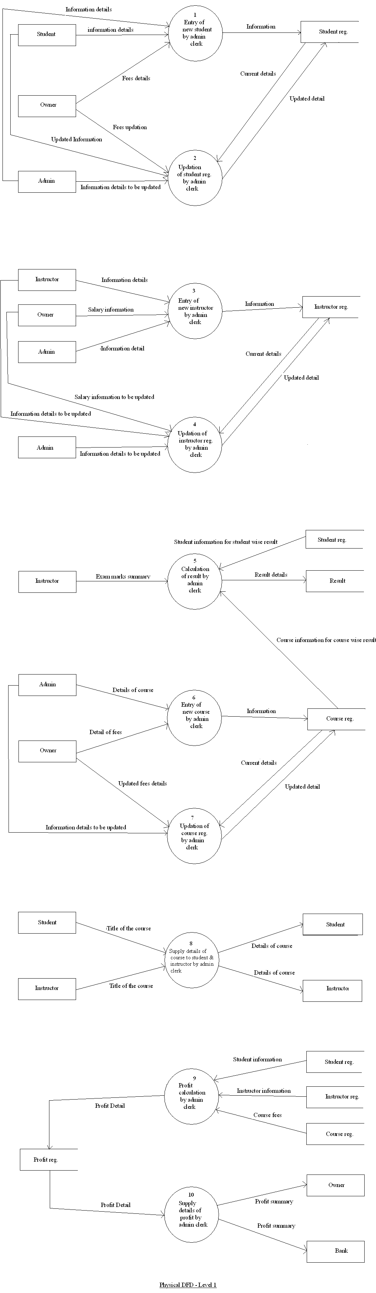


Slide 11
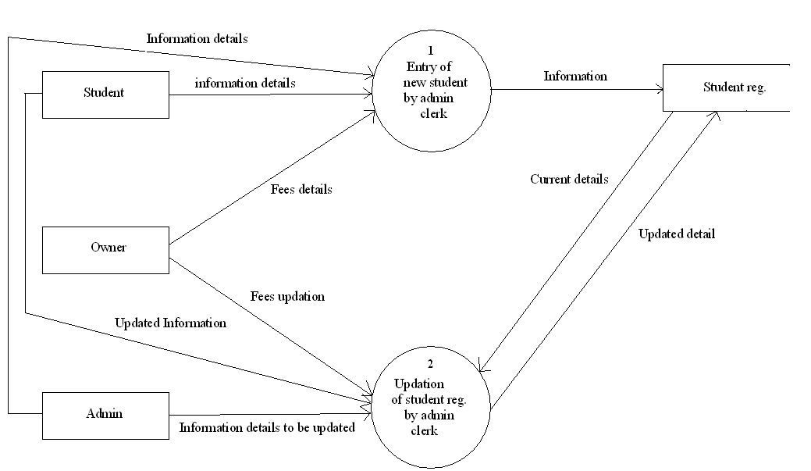

Slide 12
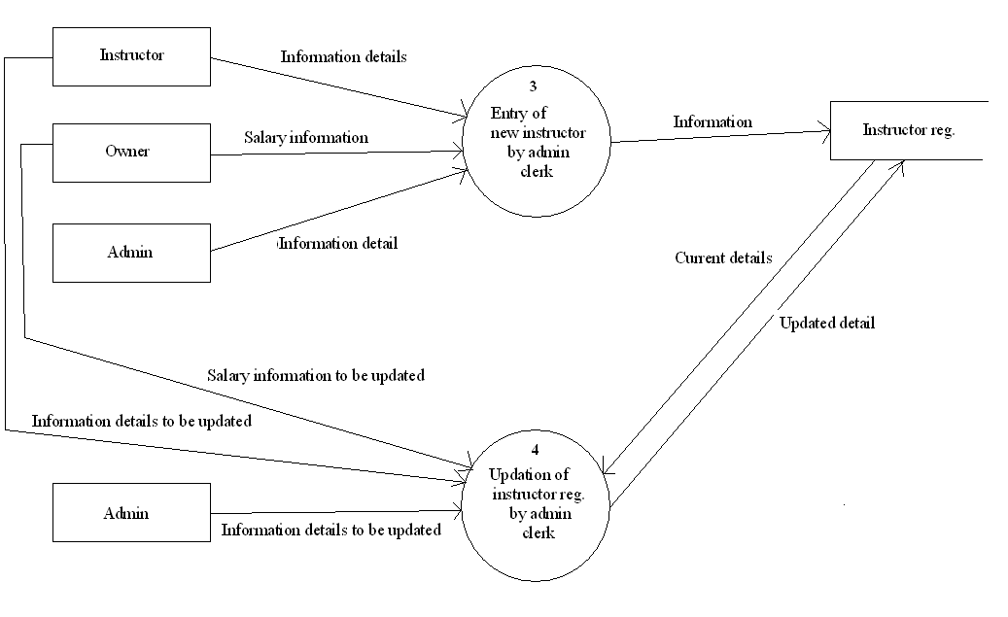

Slide 13
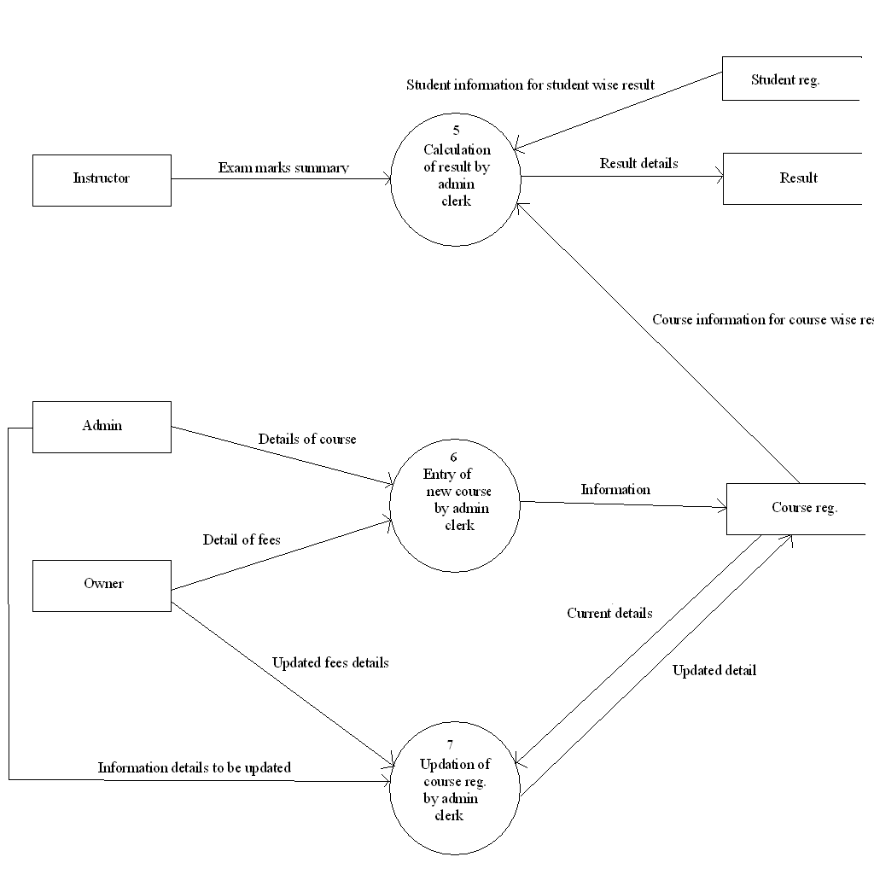

Slide 14
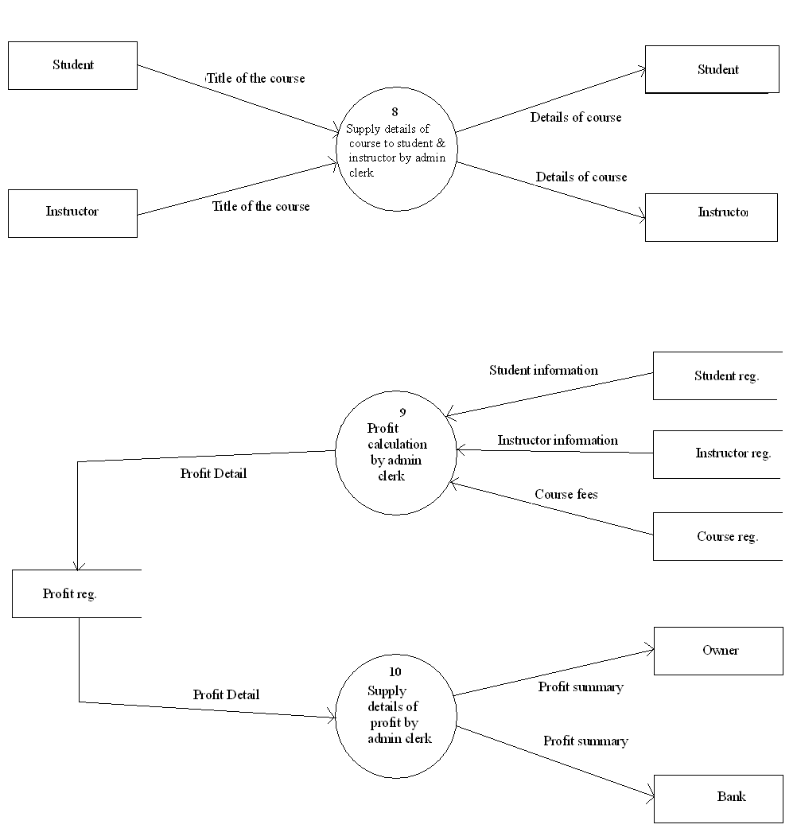

Slide 15
LOGICAL DFD

Slide 16
LEVEL 0

Slide 17
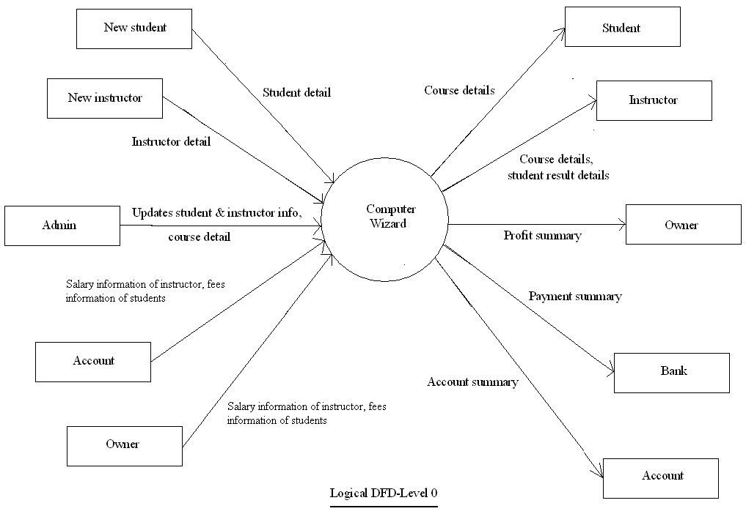

Slide 18
LEVEL 1

Slide 19
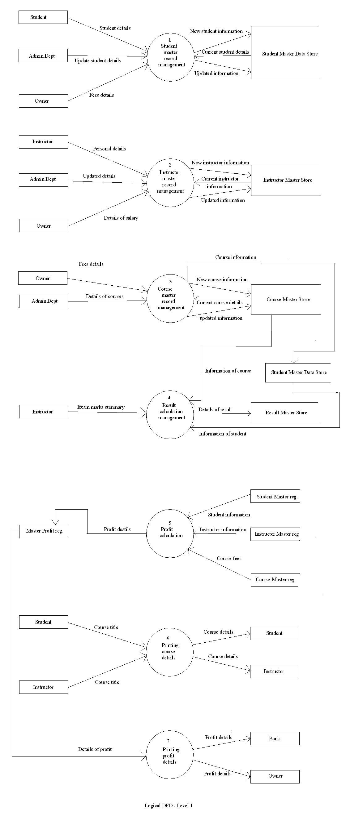

Slide 20
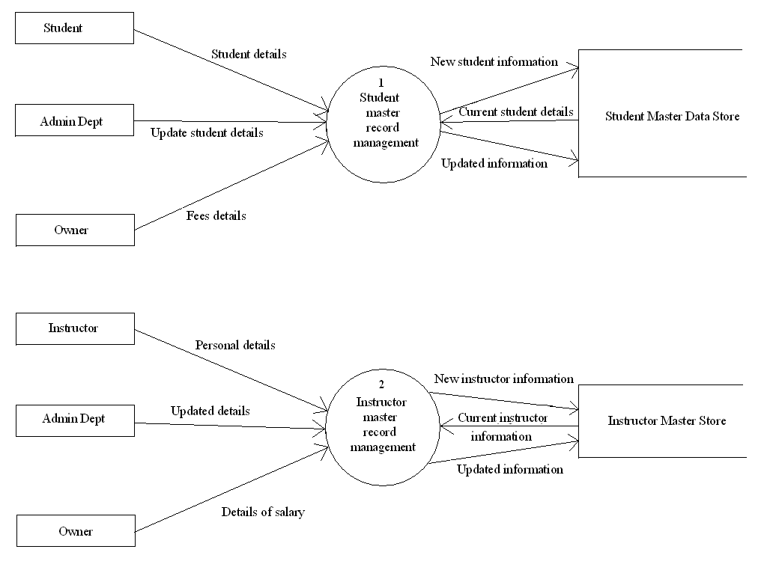

Slide 21
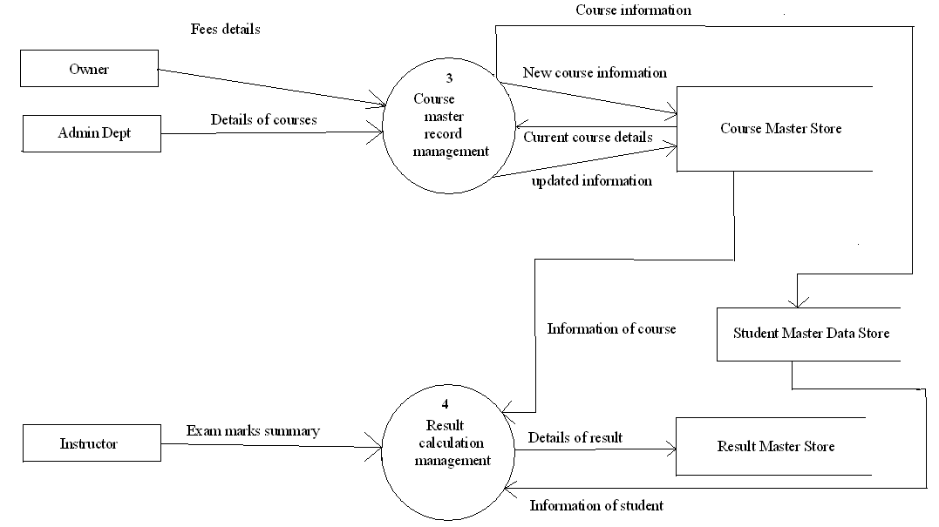

Slide 22
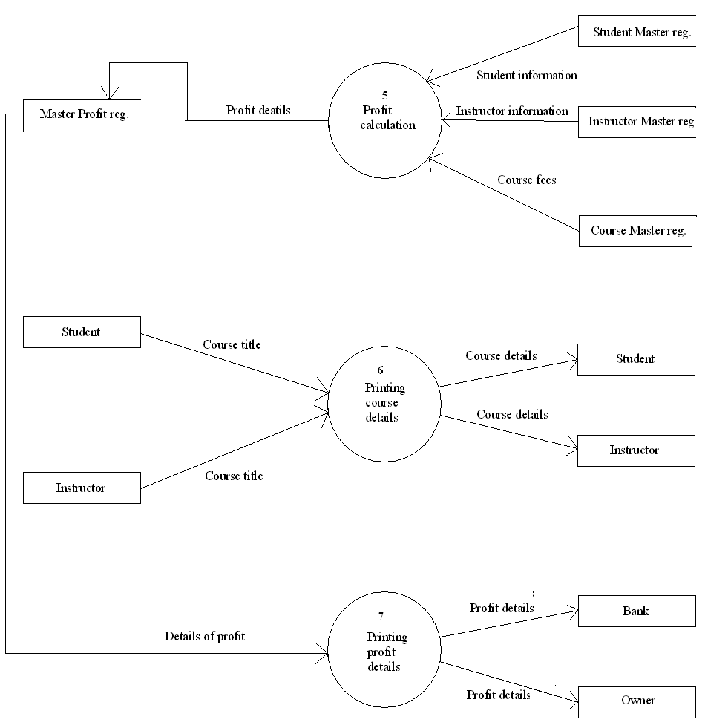

Slide 23
DATA DICTINARY
A data dictionary of a system contains generally four things:
Process
Data store
Data flow
Data element.

Slide 24
Continue…
In our software we have several
processes e.g.
Student Master Record Management,
Instructor Master Record Management. More
data stores e.g.
student master data store,
Instructor master data store. More

Slide 25
Continue…
data flows e.g.
Student’s information details,
Updating details of a student. More
Data elements e.g.
Name, Id More

Slide 26
ENTITY RELATIONSHIP DIAGRAM

Slide 27
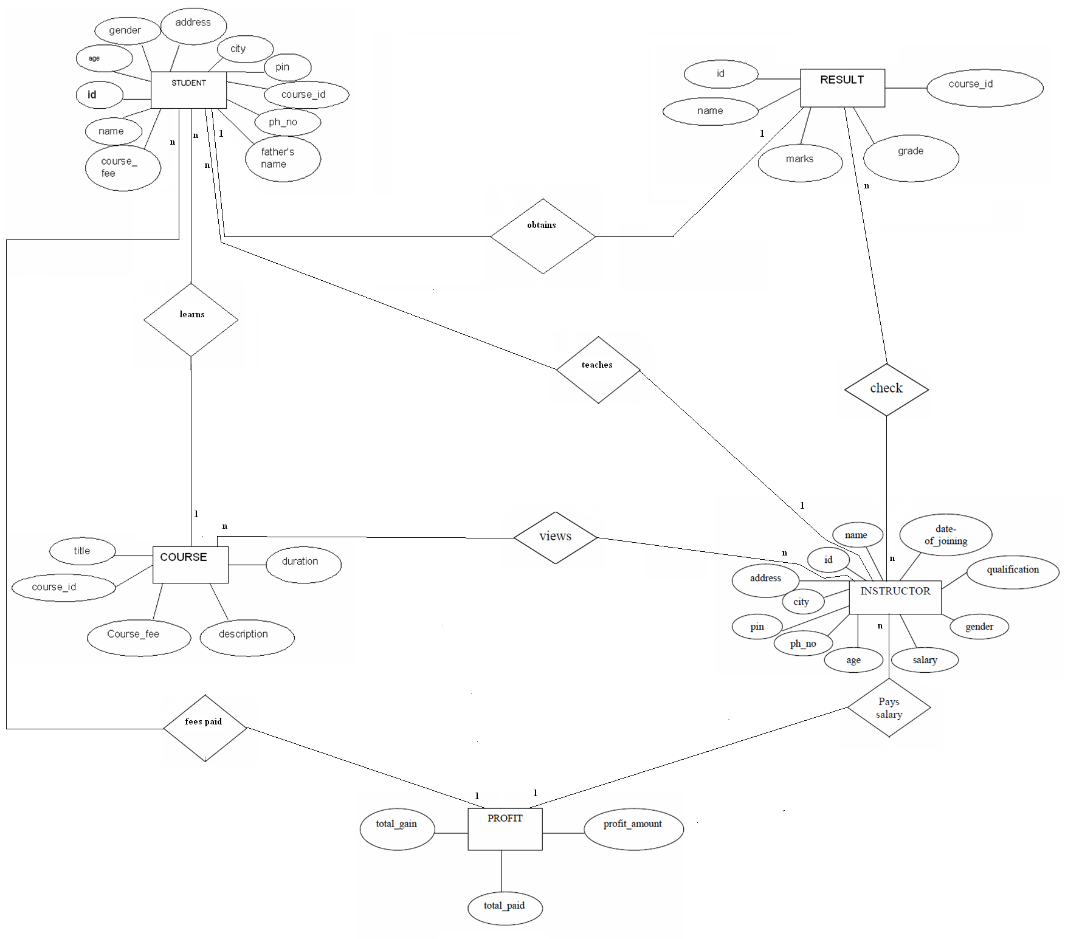

Slide 28
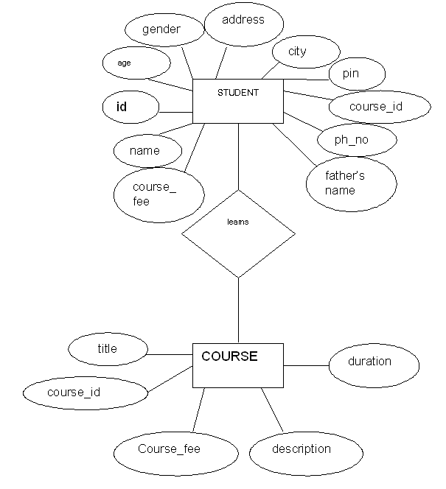
n
n
1
1

Slide 29
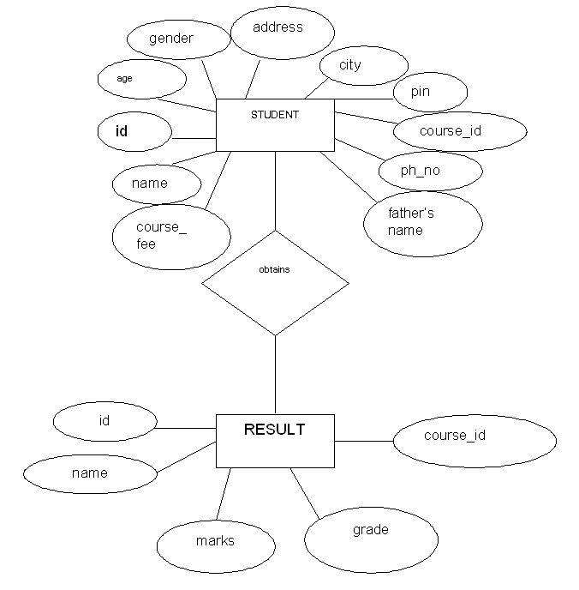
1
1
1
1

Slide 30
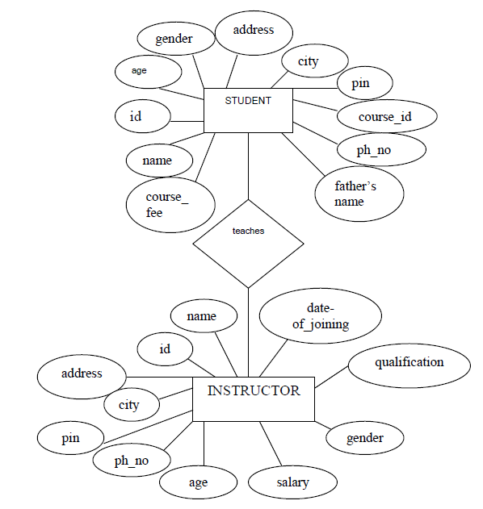
n
1

Slide 31
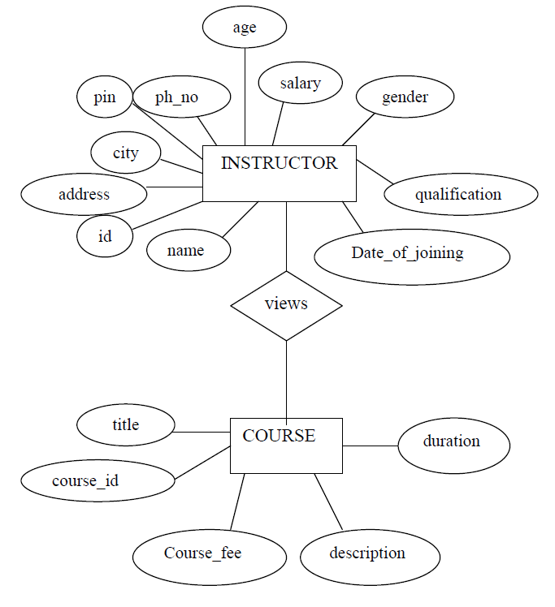
n
n

Slide 32
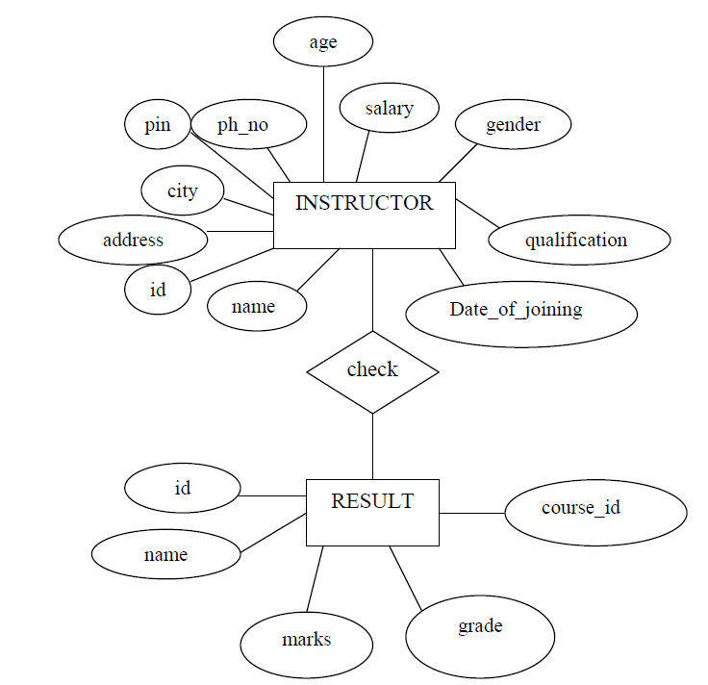
n
n

Slide 33
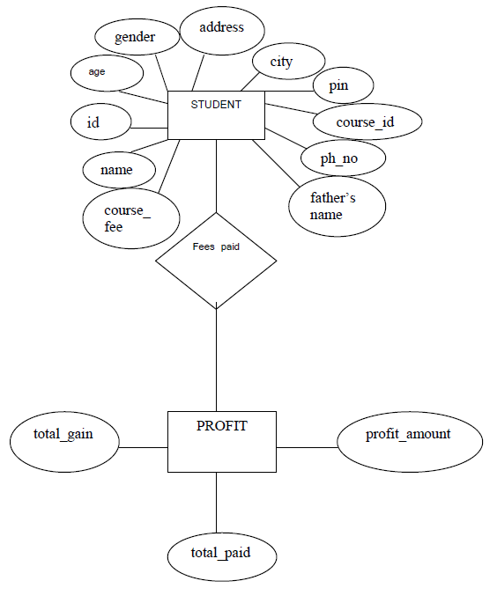
n
1

Slide 34
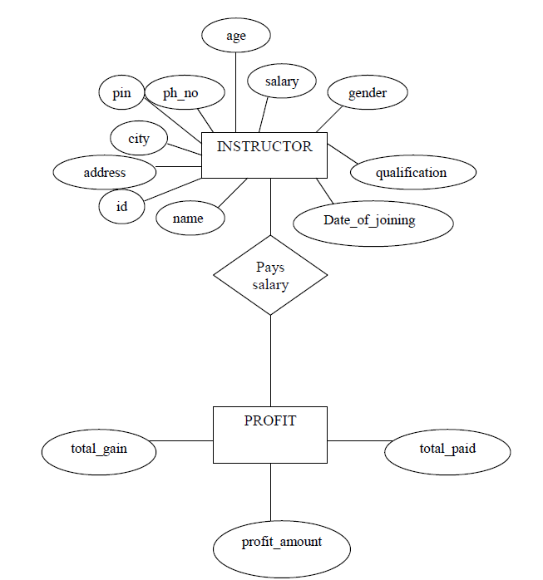
n
1

Slide 35
CLASS DIAGRAM

Slide 36
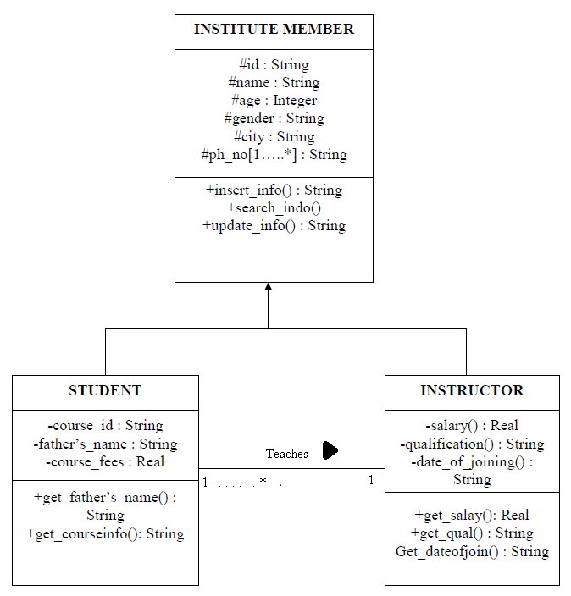

Slide 37
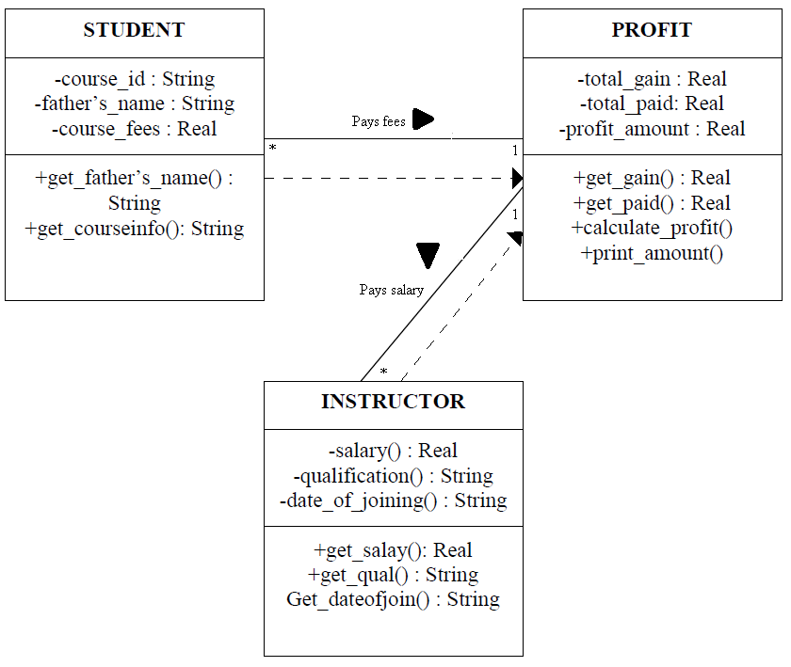

Slide 38
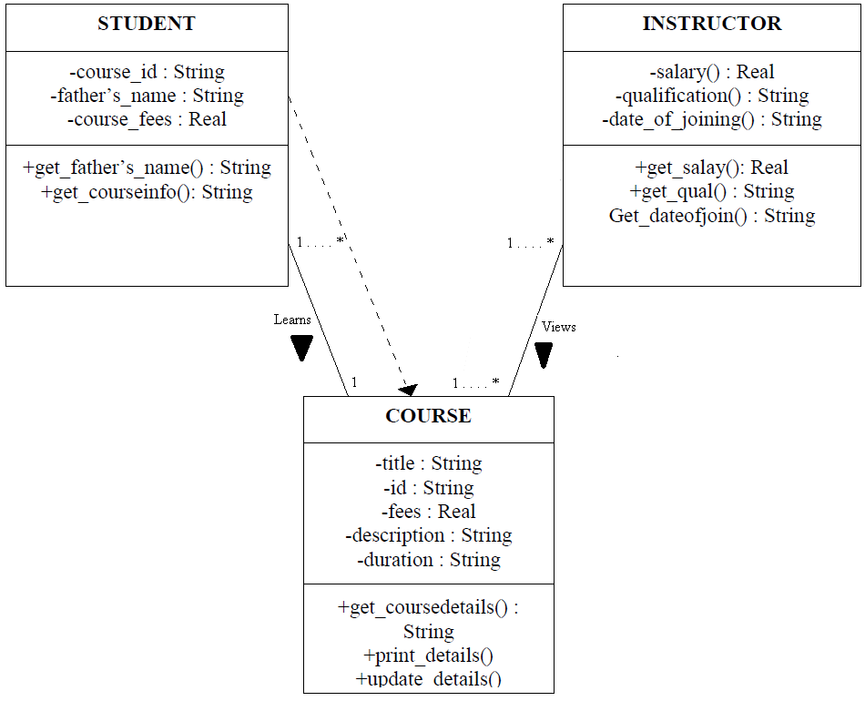

Slide 39
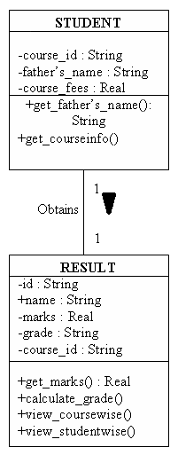

Slide 40
GENERAL CONSTRAINTS AND ASSUMPTIONS
The constraints on the development of the system is that, it will not be accessible to unauthorized users.
The person who is at the helpdesk has the full access to the desktop computer.
The instructor of the institute can access to the desktop computer but not as a whole.
Each student can do one course only at a time.
There is no facility of paying course fees in installment system for the students.
Only one instructor is assigned for teaching each course.

Slide 41
Continue..
There is no advance salary facility for instructors. All instructor have the fixed amount of salary.
The initial login and password for general users will be encrypted.

Slide 42
FUTURE SCOPE OF DEVELOPMENT
The payroll system can be added with the software of the instructors.
The software can be made online in order to allow the students to be able to interact with the members of the institution online.
Students can be allowed to access the system but not as a whole.

Slide 43
QUESTION?

Slide 44
THANK YOU

